Slide 1
EPS Week 2

Slide 2
Process
Week 1 : Sơ đồ khối, các bộ phận chung (sơ đồ bố trí chung), Chức năng của các sensor , nguyên lý hoạt động chung
Week 2 : Rack and Pinion Steering (Steering Columns and Steering Linkage Mechanisms)
Week 3 : Control Strategy and Models are usually used in EPS - part 1 (focusing on introduction of model, what is dof, pwm)
Week 4 : Control Strategy and Models are usually used in EPS - part 2 (explaining the way they are being used)
Week 5 : Use case and solution in real life (advantages + disadvantages), new solution (being researched) ( 4-wheel steering, …)
Week 6: Back-up week.
Week 7 : Present about EPS system.

Slide 3
Overview
Steering ratios, turn lock-to-lock, steering stop
Types of steering gear
Rack and pinion
Recirculation ball
Toe angle, camber angle and its effect

Slide 4
Steering
The steering system can be broken into two major components.
The steering column and shaft
All the components located in the passenger compartment
The steering gear and linkage
The steering gear and linkage converts the rotary motion of the steering wheel into linear motion of the steering linkage
A set of gears is needed to accomplish this
Linkage is needed to connect the steering knuckles (khớp tay lái) to the steering gear because the steering knuckles must move up and down with the suspension

Slide 5
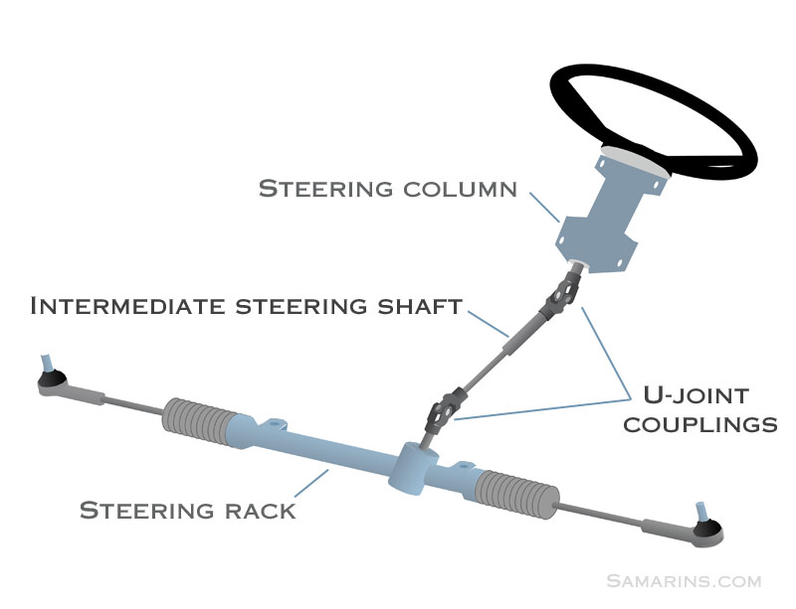

Slide 6
Steering ratio
1º
1º
The steering ratio is the number of turns of the steering wheel / number of turns of the steering knuckle. (khớp tay lái)
Most passenger cars have a steering ratio of around 16 to 1.
16 degrees of rotation of the steering wheel should produce 1 degree of rotation of the steering knuckle.
16º

Slide 7
Steering ratio
If the engine stalls the vehicle must be capable of being steered safely to a stop.
A lower steering ratio will have a quicker steering response but may make the vehicle nearly impossible to steer if the power assist fails.
The heavier weight applied to the front tires of a trucks calls for a steering ratio of 20 to 1 or higher.
Notes:
Nếu động cơ dừng máy, xe phải có khả năng dừng lại một cách an toàn.Tỷ số lái thấp hơn sẽ có phản ứng lái nhanh hơn nhưng có thể khiến xe gần như không thể bẻ lái nếu trợ lực điện bị lỗi.Trọng lượng nặng hơn áp dụng cho lốp trước của xe tải yêu cầu tỷ số lái từ 20 đến 1 hoặc cao hơn.

Slide 8

Turns lock-to-lock
If turning the wheels all the way to the left until the steering will no longer turn and then count the number of rotations of the steering wheel can turn to the right until it reaches the steering lock – that is the number of turns lock-to-lock.
For example, if a car has a steering ratio of 18:1 and the front wheels have a maximum deflection of 25°, the steering wheel must turn 25°x18, which is 450°. So, the entire steering goes from -25° to +25° giving a lock-to-lock angle at the steering wheel of 900°, or 2.5 turns (900° / 360).
Most passenger cars have about 3+1/3 turns of steering lock-to-lock

Slide 9
Steering stops
A steering stop is a mechanism in the steering linkage or steering gear that limits how far the steering knuckles can rotate.
Without steering stops the sidewalls of the tires will contact the fenders, frame or control arms.
On some suspension systems there are adjustable bolts on the control arms that contact a tab on the steering knuckle at full lock.
Notes:
Trên một số hệ thống treo có các bu lông điều chỉnh trên tay điều khiển tiếp xúc với một mấu trên khớp tay lái khi khóa hoàn toàn.

Slide 10
Steering stops
On most modern cars the steering stop is built into the steering gear.
If the steering linkage is serviced improperly, it may be possible for the steering to turn 35 degrees to the right and only 25 degrees to the left.
If this was the case the tires may be damaged when making a hard turn as the steering angle exceeds the design limits.

Slide 11
Types of steering gear
There are two types of steering gear used on modern cars:
Rack and Pinion
Used on the majority of passenger cars
Re-circulating Ball steering box
Used on mostly on trucks
Sometimes called linkage steering

Slide 12
Rack and Pinion Steering

Slide 13
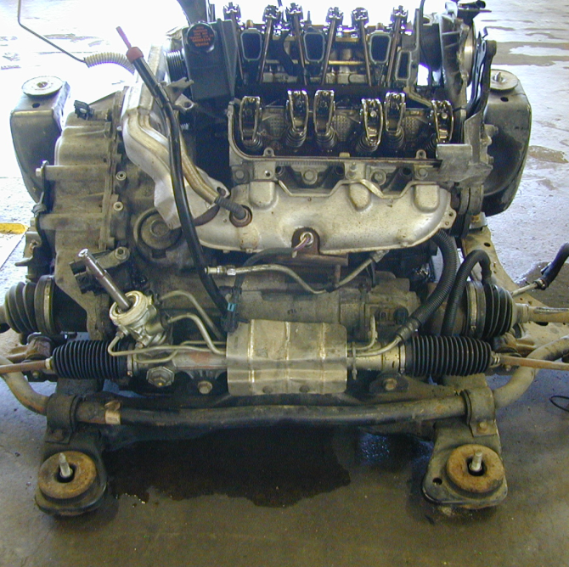
Rack and pinion steering
On a front wheel drive car with the engine mounted transversely the steering rack can be mounted on the sub-frame directly behind the engine/transaxle.
Notes:
Trên xe ô tô dẫn động cầu trước với động cơ lắp ngang, giá lái có thể được gắn trên khung phụ ngay phía sau động cơ / bánh xe

Slide 14
Rack and pinion
Pinion gear
Rack
Rack and pinion steering is very simple and has few moving parts.
When the pinion gear rotates the rack moves laterally.
The pinion gear is connected to the steering wheel – the rack is connected to the steering knuckles.

Slide 15
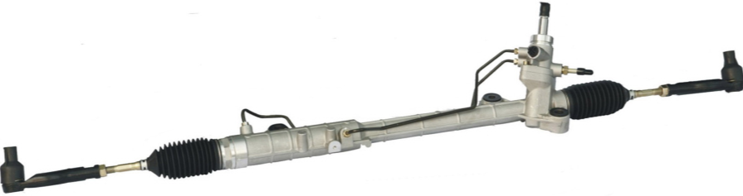
Rack and pinion steering linkage
Pinion shaft
Rack Housing
Tie rod
Bellows
Tie rod
Mount bushings
The rack and pinion gears are mounted in an aluminum housing that usually sits on top of the front sub-frame.
Tie rods connect each end of the rack to the steering knuckles.
The rack and inner tie rod ends are protected by rubber bellows.

Slide 16
Rack and pinion steering
Pinion bearings
Pinion shaft
Rack bearing
The rack and pinion gears are located inside an aluminum housing that is bolted to the frame or firewall.
The rack is free to slide laterally on bores machined into the housing.
The pinion gear shaft is supported on ball bearings at the top and bottom.

Slide 17
Rack and pinion steering
Inner tie rod end
Bellows
Pinion shaft seal
Rack Seal
Rack Seal
Air pressure equalization passage
The housing is filled with lubricating oil.
Seals on the ends of the housing and pinion shaft keep the fluid from leaking out.
Rubber bellows protect the ends of the rack and inner tie rod ends from dirt and moisture damage.

Slide 18
Rack and pinion steering
Bellows
Air pressure equalization passage
An air passage connects the left and right bellows.
Without the air passage the bellows would collapse on one side and balloon on the other as the vehicle is steered

Slide 19
Tie rods
Garter spring
Nylon ball seat
Tie rod ends are ball and socket joints like ball joints.
The tie rod ends must pivot with the steering and flex up and down with suspension movement.
Tie rods connect the steering gear to the steering knuckles.
The length of tie rods must be adjustable so that the toe angle for each wheel can be adjusted.

Slide 20
Tie rods for rack and pinion steering
Outer tie rod end
Jamb nut
Inner tie rod end
The tie rod assembly for rack and pinion steering has 3 components:
Outer tie rod end
Inner tie rod end
Jamb nut [lock nut]

Slide 21
Tie rod length adjustment
Flats on tie rod
Jamb nut
When the inner toe rod is rotated the assembly gets shorter, when it is rotated in the opposite direction it gets longer.
Most inner tie rods have machined flats to allow the tie rod to be turned using an open end wrench.

Slide 22
Linkage type steering
Steering arm
Tie rod
Tie rod
Steering knuckle
Center link
Frame
Pitman arm
Idler arm
Recirculating ball steering box
Linkage type steering is often called a parallelogram linkage because the angles formed by the links produces a parallelogram.
With the steering straight ahead the linkage forms a rectangle.
Notes:
Ko dùng motor điện

Slide 23
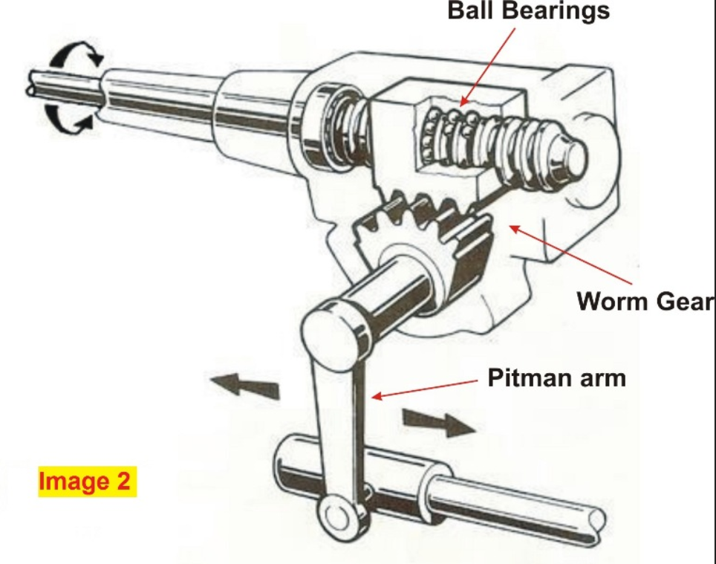

Slide 24
Toe angle

Slide 25
Toe
59 7/8”
60 1/8”
Toe is an alignment angle established by the length of the tie rods.
Toe is the difference in distance between the two front tires measured at the front [leading edge]and rear [trailing edge].
Toe is normally expressed in inches but can also be expressed in millimeters or degrees.

Slide 26
Toe-in
59 7/8”
- ¼” toe-in
60 1/8”
When the tires are closer at the front the condition is called toe-in.
Toe-in is normally displayed on an alignment machine precede by a negative sign [-].

Slide 27
Toe-out
60 1/8”
+ ¼” toe-out
59 7/8”
When the tires are closer at the rear the condition is called toe-out.
Toe-out is normally displayed on an alignment machine precede by a positive sign [+].

Slide 28
Zero toe
60”
60”
When the vehicle is driven straight ahead at highway speeds the tires should be at zero toe.
Most cars and trucks are aligned for a small amount of toe-in to compensate for compliance in the control arm bushings.
The forces caused by positive scrub radius causes the tire to want to toe-out as the vehicle comes up to speed.

Slide 29
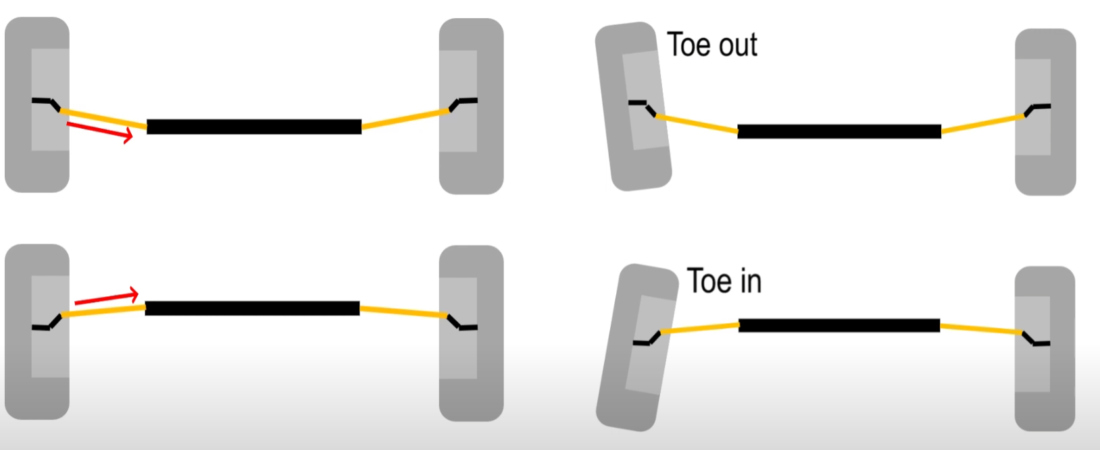
Toe change during jounce/rebound
As the out-board end of the tie rod moves up and down with the suspension it swings through an arc.
As the tie rod swings up and down during jounce/rebound the tire is pulled toward toe-in if the steering arms are located in front of the axle centerline.

Slide 30
Toe change during rebound
The location of the steering arm relative to the axle centerline determines whether the tire is pulled into toe-in or toe-out during jounce and rebound.
If the tie rods attach to the steering knuckle behind the axle centerline the tires will toe-out during jounce and rebound.

Slide 31
Bump steer
10.5”
9.5”
¼” toe change
½ ” toe change
If both tie rods are the same length the toe change will be equal on both sides and the vehicle will not pull.
If one tie rod is longer then the car will momentarily pull to the side with the shorter tie rod when ever the tires encounter a bump.

Slide 32
Bump Steer
The tie rods should be horizontal when the vehicle is at its static height.
If one side of the center link is higher or lower than the other side the car will bump steer to that side.
This condition is usually the result of an improperly installed idle arm.

